Slide 1

School Crime Stoppers Training
School Year 2024 – 2025 & 25-26
Wednesday, April 16, 2025
Zoom
Christopher Anderson, SSSD Administrator
Jim McDonald, Board Chairman, Guam Crime Stoppers
Officer Paul Tapao, GPD Crime Stoppers Coordinator

Slide 2

AGENDA
Housekeeping Rules
Goals and Objectives of GDOE Crime Stoppers Program
School Safety Coordinator (SSC) Duties and Responsibilities
School Crime Stoppers Coordinator (SCSC) Duties and Responsibilities
School Crime Stoppers Program
GDOE Website: Crime Stoppers In School web page
How to submit Tips
Tip Payout
Request for GPD presentations
Recommended Grades for GPD Presentations
Guam Crime Stoppers Program-Parent Progam
Notes:
Mr. Anderson

Slide 3
HOUSE KEEPING RULES
Sign In Using the Zoom Chat: First/Last Name / School
Put yourselves on MUTE throughout the training
Raise Your Hand using the Icon or post your question in the chat….Sherry Sanchez will flag your inquiry/comment
Notes:
Mr. Anderson

Slide 4
GOALS AND OBJECTIVES
To educate schools on the Board Policy and Standard Operating Procedures governing the School Crime Stoppers Program
For each school to establish a crime reporting program that provides a safe learning environment for everyone.
Encourage students and community to submit anonymous tips using either a tip box or the P3 app
Empower students and community with a sense of ownership knowing that something will be done to address crime in schools and in Guam.
***Thank you to all schools who answered the survey

Slide 5

SCHOOL CRIME STOPPERS PROGRAM
Guam Public Law 31-100 created School Crime Stoppers to provide a safe school program in our public school system on September 30, 2011. This program aids law enforcement and school officials in reducing criminal activity and related problems in schools, on school grounds, and in the nearby communities. Situations involving the possession of illegal drugs and weapons, and destruction of property will be addressed.
BP 472
SOP 1200-008
GDOE Crime Stoppers Web Page Address: https://www.gdoe.net/District/Department/9-Student-Support-Services-Division-SSSD/1544-Crime-Stoppers-in-Schools.html
Notes:
Mr. Anderson slide

Slide 6
Board Policy 472 (Outline)
Effective: 3/21/12
Defines the role of a School Safety Coordinator as a collateral duty
Defines the role/duties of a School Crime Stoppers Coordinator
Data Collection: Both the SSC and the SCSC work in tandem to provide data to obtain grants to increase student involvement and promotion of a safe-crime free schools
  Published Quarterly on the GDOE website
Program to be implemented in ALL GDOE schools

Slide 7
SOP 1200-008 (Outline)
Effective: 11/1/12
Procedures:
  School Principal to appoint a SSC NLT the 3 weeks from 1st day of school year
  Program in place NLT 6 weeks from 1st day of school year
  Crime Stoppers Flow Chart
Responsibilities of the SSC: (Next Slide)
Training: Provided by the SCSC and Guam Crime Stoppers
Reports: School administrator/designee to provide Tips data quarterly to SSSD for publication on website

Slide 8
School Safety Coordinator (SSC) Duties and Responsibilities
Overseeing the DOE School Crime Stopper Program as a collateral duty.
Coordinate with the School Crime Stoppers Coordinator-GPD (SCSC) to conduct training on the P3 app and other ways of submitting tips
Check the “Tips Box” daily and notify the SCSC if there are tips for disposition and action. (If still in use)
Organize awareness and education events for students and the broader community. (Target age group 3rd grade and up)
Collaborate with the SCSC in the collection and reporting of statistical data involving tips on a quarterly basis.
  The quarterly report format will itemize each tip, how it was received, and whether it was a crime or school rules violation. The report is submitted to the Student Support Services Division and published on the DOE website.

Slide 9
IMPORTANT NOTES FOR DESIGNATED SSC
All designated SSC will have to fill out and submit a “Confidentiality Clause” prepared by the Guam Crime Stoppers Board to ensure full anonymity is practiced.
All designated SSC will ensure that all tip information remains confidential.
Any information that is released will be punishable by law!!!
***Note: High Schools still need to have SSC..SROs will assume role of Crime Stoppers Liaisons
Notes:
Sir, is this slide still going to stay? Not sure if you wanted me to discuss with Officer Tapao.

Slide 10
School Crime Stoppers Coordinator (GPD) Duties and Responsibilities
Organize awareness and education events for students and the broader community. (Target age group 3rd grade and up) with AG, GPD, Mayor’s Council, etc.. and provide training for administrators, faculty, staff, parent organizations, and families
Partner with schools and Guam Crime Stoppers to identify needs (i.e., phone service, online web tip support, etc..
Forward reports of tips that have led to arrests to the Guam Crimes Stoppers Board of Directors
Refer violations of school/department policy to the school administrator/SCC for disciplinary action
Collaborate with all SCCs to collect/publish quarterly data on calls/tips that are violations of school/department policy or criminal acts.
SROs in the 6 High Schools (GWHS, SHS, THS, JFK, SSHS, and OHS)will assist the SCSC with this responsibility

Slide 11
SAMPLE DATA: SY 2017-2018
Notes:
Just spoke with Officer Tapao this morning. He was having challenges uploading his 4th quarter report. He will be entering after his meeting. As soon as I get the data, I will extract and add to the PPT.

Slide 12
COMMON YOUTH CRIMES COMMITTED
Crime Stoppers will report any type of crime back to the school that is sanctioned in Title 9 G.C.A.
Drugs: Inhalants; Synthetic Cannabis (Spice); Marijuana and Crystal Methamphetamines (Drug Ice)
Assault
Criminal Property Damage- Graffitti
Thefts
Robbery
Burglary-School Break-ins
Criminal Sexual Conduct

Slide 13



HOW STUDENTS SUBMIT TIPS
There are three (3) ways for students to provide a tip while remaining anonymous. **Please review with your students how to download the app and navigate online and submit tips
  P3 Mobile App
  Tip Box
  Online
  ***Note: 477-HELP NO LONGER OPERATIONAL
Notes:
Paul Tapao

Slide 14

Notes:
Paul Tapao

Slide 15
TIP BOX
**Intent is to phase out and move to exclusive use of the P3 App If school uses one:
The responsibility of the School Safety Coordinator (SSC) to designate the placement of the tip box.
SSC will check the tip box on a daily basis.
Should a tip be generated, the SSC will contact the SCSC and assess if the tip is criminal in nature or administrative concerns.
All criminal tips will be handled by the SCSC-GPD in disseminating information to respective Law Enforcement Agencies.
* The SSC and the SCSC-GPD will work together to direct tips.
Notes:
Paul Tapao

Slide 16
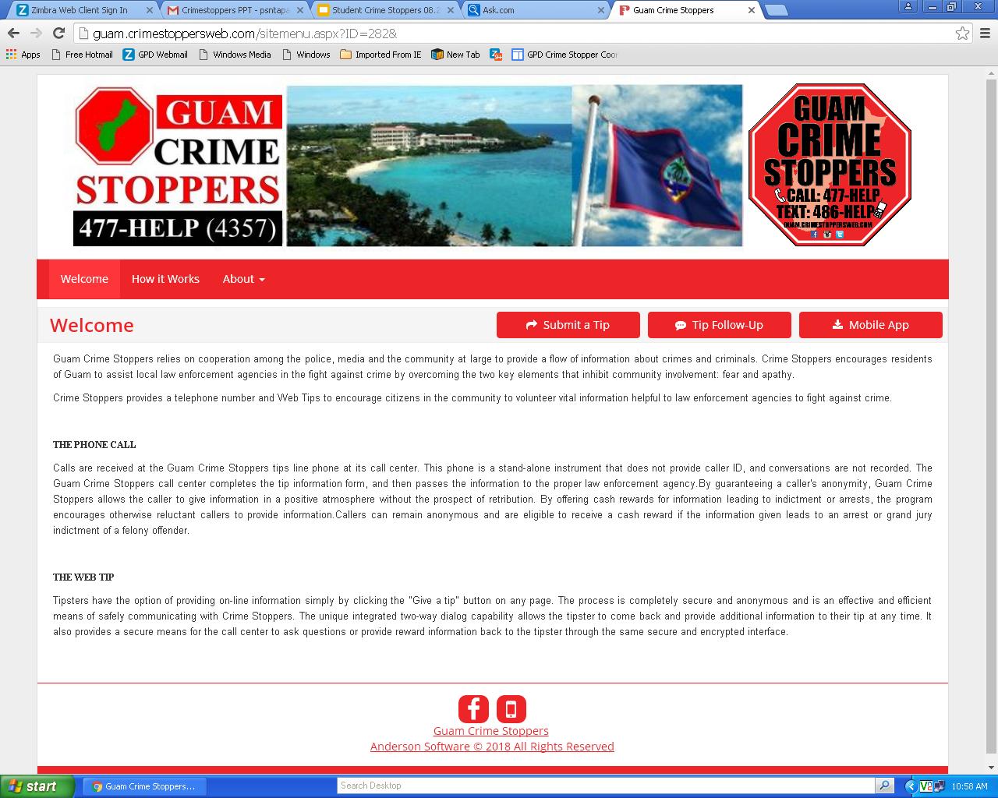
ONLINE https://sites.google.com/a/gdoe.net/studentsupportservices/home/crime-stoppers-in-schools
OR www.guam.crimestoppersweb.com
Notes:
Paul Tapao

Slide 17
TIP PAY OUT
Tips for School Crime Stoppers are paid based on:
    School Sanctions (e.g. detention or
    suspension) **Only if it is criminal/meets item #2
    2. An arrest or confinement at the Department
    of Youth Affairs
The student will be paid based on a matrix and the crime up to $200.00. (Note: May increase to $500.00)

Slide 18
REQUEST FOR GPD PRESENTATIONS
To coordinate all training/presentations in all GDOE schools with the Guam Police Department, GDOE Student Support Services Division has developed a Google Request Form for schools to access via SSSD Links on our website.
https://www.gdoe.net/District/Department/9-Student-Support-Services-Division-SSSD/1621-Request-for-G-P-D.html
The Google Request Form will assist GPD with managing all school requests for presentations/training. The information requested is what GPD needs in order to process the request. If they need additional information, they will contact you directly. The data collected from the form will also let GPD and the Department understand that types of training that are in greatest demand. Upon electronic submission, GPD will provide a response to the request within five (5) business days. If you don't receive a response, please contact Student Support.
Notes:
Paul Tapao

Slide 19
RECOMMENDED GRADE FOR GPD PRESENTATION
Elementary (3rd – 5th)
Middle – (6th – 8th)
High – (9th and 11th)
It is the responsibility of the SSC to coordinate dates and times for school presentations with the SCSC.
All presentations are highly encouraged to be held in a classroom setting. Please, NO CAFETERIA!
***Please follow up with all training requests if you don’t hear back from GPD by calling/emailing SSSD (sssd@gdoe.net) or GPD (chief@gpd.guam.gov)
Notes:
Paul Tapao

Slide 20

QUESTIONS

Slide 21
Guam Crime stoppers
James T. McDonald
Board Chairman, Guam Crime Stoppers
Board of Director of USA Crime Stoppers:
Director, Region 12 U.S.A Crime Stoppers Program:
Representing the States of Wyoming, Montana, and North/South Dakota

Slide 22
AGENDA
Introduction
What, Who, Why, How
Public – Police – Public Sector
Communicating CS -Top 5 Reasons

Slide 23


Introduction
Crime Stoppers was the brainchild of a young Albuquerque, New Mexico detective, Greg MacAleese, who was concerned by the number of unsolved cases. He and other detectives were particularly frustrated that all possible leads to a case they were working on had been exhausted regarding the murder of a young college student. He felt information that would solve the crime was available from someone other than the criminal. That theory was a major factor that brought about anonymous tips for individuals to come forward with information in solving crimes. Members of the local community media and law enforcement came together in partnership to begin the effort to provide crime solving assistance to law enforcement and the first Crime Stoppers program was born on September 8, 1976.

Slide 24
Introduction
A cash reward was offered to individuals that provided “anonymous” tips to Crime Stoppers with information which would lead to the arrest of the persons responsible for the crime. The local media publicized the first crime of the week and a phone number to call with the information. A tip received by the program resulted in the arrest of 3 men within 72 hours who had been involved in the homicide of the young college student that occurred 4 months earlier. Today, community and Crime Stoppers programs around the World and are represented by the national regions of the United States, Canada, the Caribbean, Latin America, Europe, Australia, and the South Western Pacific. The Crime Stoppers Program has enjoyed great success with the information received which has led to the arrest and the indictment of those responsible for committing felony offenses boosting an average conviction rate of approximately 95% on cases solved by a tip to the program.

Slide 25
What is Crime stoppers
Guam Crime Stoppers is a not-for-profit organization established August 1985.
Crime Stoppers program is funded by private donations and fund raising.
NO TAX DOLLARS are involved
Rewards are distributed in a private manner to the callers
“Anonymous” callers are eligible for rewards up to $1,000

Slide 26
who are members of Crime stoppers
Board of directors are VOLUNTEERS from the Civilian community
Provide direction, financial, and promotional activities of the program
Board of directors enhance the community involvement vital to the program’s success
Board of directors practice protocols of anonymity
Funding for the program are made possible through fundraising events, grants, corporate support and other donations.

Slide 27
Why does crime stoppers work?
Greater community awareness that there is a crime problem
Willingness from community to fight back against crime
Improved relationship between police, media, and the community

Slide 28
How does crime stoppers work?
Crime Stoppers utilizes three-pronged approach to solving the crime problem.
Crime Stoppers relies on cooperation between:
  Police
  Media
  General community

Slide 29
Public – police – private sector (P3)
Public – Police – Private Sector (P3)
Integrated and state-of-the-art tip acquisition and tip management solution by Navigate 360
Leading choice of Crime Stoppers Programs, Law Enforcement Agencies, Campus Safety Programs, and Federal Agency Initiatives
P3 is a cloud-based tip and intelligence management

Slide 30


COMMUNICATING CRIME STOPPERS

Slide 31
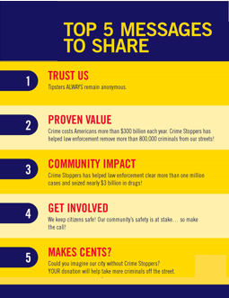

Slide 32
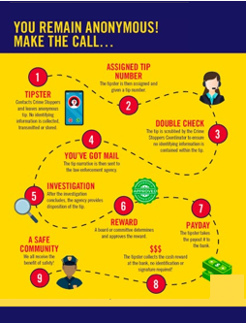

Slide 33
How to Submit a Tip
All tips provided to Guam Crime Stoppers remain completely anonymous.
Download the P3 Tips app or submit a tip online at www.guam.crimestoppersweb.com

Slide 34
You Tip Us and We Tip You
If the information provided leads to an arrest, you can receive a cash reward of up to $1,000.

Slide 35

guamcrimestoppersweb.com
Contacts:
Jim McDonald, President, Guam Crime Stoppers Program @ jtmc1959@yahoo.com
Sgt. Paul Tapao, GPD @ psntapao@gdoe.net; paul.tapao@gpd.guam.gov
Christopher Anderson, SSSD Administrator @ cjanderson@gdoe.net
Sherry Sanchez, SAO Supervisor @ sherry.sanchez@gdoe.net

