Slide 1
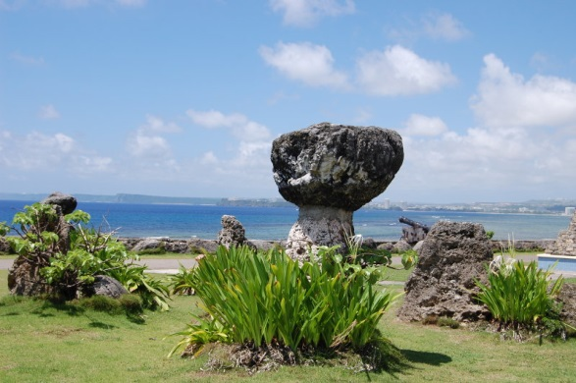
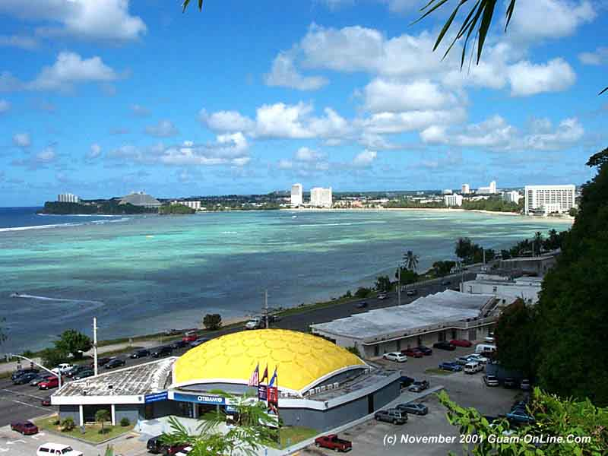
Tuberculosis Update
Cecilia Teresa T. Arciaga

Slide 2
PUBLIC LAW 22-130
Title 10, Guam Code Annotated Sections: 3302, 3303, 3304
as amended by Public Law 22-130 – Duty to Report
Sections: 3308- The Director or his designee to examine
records or reports to fully investigate the case
Section: 3309-10 Isolation and Quarantine Regulation
Section: 3311-12 Placarding/Violation of Isolation or
Quarantine and Placarding
Section: 3309- Testing for Tuberculosis

Slide 3
Guam Public Law 22-130 Section 3309
“That no student shall be permitted to attend any public or private school, college or university on Guam unless they have on file with the enrolling officer of such school, college or university a report of a TB Skin Test. If the student is entering from the USA or states or its territories, such test must have been conducted within 6 months prior to enrollment”.

Slide 4
Guam Public Law 22-130
“If a student is found to have a Positive PPD skin TEST…….Certificate of TB Evaluation

Slide 5
TB EPIDEMIOLOGY GUAM
In 2006 54 cases were reported at 31.5 /100,000 population. However, in 2007 an alarming 70% increase was reported at 53/100,000 population. Since 2011 we have seen a steady decline of active case to a low of 30/100,000 for 2013.

Slide 6
Table 1
Trend of Notification 2003-2013, All Types
Annual Number of Notified Cases
Year | Total Number of Cases | Population | Rates Per 100,000 Population
2003 | 61 | 156,157 | 39.1
2004 | 51 | 156,610 | 32.5
2005 | 64 | 157,065 | 40.7
2006 | 54 | 157,521 | 34.3
2007 | 92 | 157,978 | 58.2
2008 | 90 | 158,437 | 56.8
2009 | 102 | 158,897 | 64.2
2010 | 101 | 159,358 | 63.4
2011 | 81 | 159,821 | 50.7
2012 | 68 | 160,285 | 42.4
2013 | 48 | 160,350 | 29.9

Slide 7
Table 2 Trend Notification, 2003-2013, All Types Annual Number of Notified Cases

Slide 8
Table 3
TB Incidence Rate Between
Guam, United States and Hawaii
2002-2012
YEAR | GUAM | HAWAII | USA
2002 | 41.7 | 11.9 | 5.2
2003 | 39.1 | 9.3 | 5.1
2004 | 32.5 | 9.2 | 4.9
2005 | 40.7 | 8.8 | 4.8
2006 | 34.3 | 8.9 | 4.6
2007 | 58.2 | 9.5 | 4.4
2008 | 56.8 | 9.6 | 4.2
2009 | 64.2 | 9.1 | 3.8
2010 | 63.4 | 8.4 | 3.6
2011 | 50.7 | 8.9 | 3.3
2012 | 42.4 | 8.4 | 3.1

Slide 9
Table 4 TB Incidence Rates Between Guam, Hawaii, United States 2002-2012

Slide 10
Table 5 TB in the US-Affiliated Pacific Islands 2012
Jurisdiction | Cases | Case Rate | Population
American Samoa | 1 | 1.8 | 54,947
Guam | 68 | 42.4 | 160,285
Palau | 4 | 19.0 | 21,032
Federated States of Micronesia | 173 | 162.4 | 106,487
N. Mariana Islands (CNMI) | 30 | 58.3 | 51,395
Marshall Islands | 147 | 214.66 | 68,480
USAPI Regional | 423 | 91.4 | 462,626
Hawaii | 117 | 8.4 | 1,392,313
United Stated of America | 9,951 | 3.1 | 313,914,040

Slide 11
Case Rate of Guam/USA Affiliated Pacific Is. 2012
Guam TB Case Rate
6X more than Hawaii
15X more than USA
USA Affiliated Pacific Island Jurisdictions
10X more than Hawaii
27X more than USA

Slide 12
Table 6 Ethnicity Breakdown 2003 – 2013

Slide 13
Table 7 TB Cases By Ethnicity 2003-2013

Slide 14
Table 8 Age Breakdown 2003-2013

Slide 15
Table 9 TB Disease Cases By Age Group 2003-2013

Slide 16
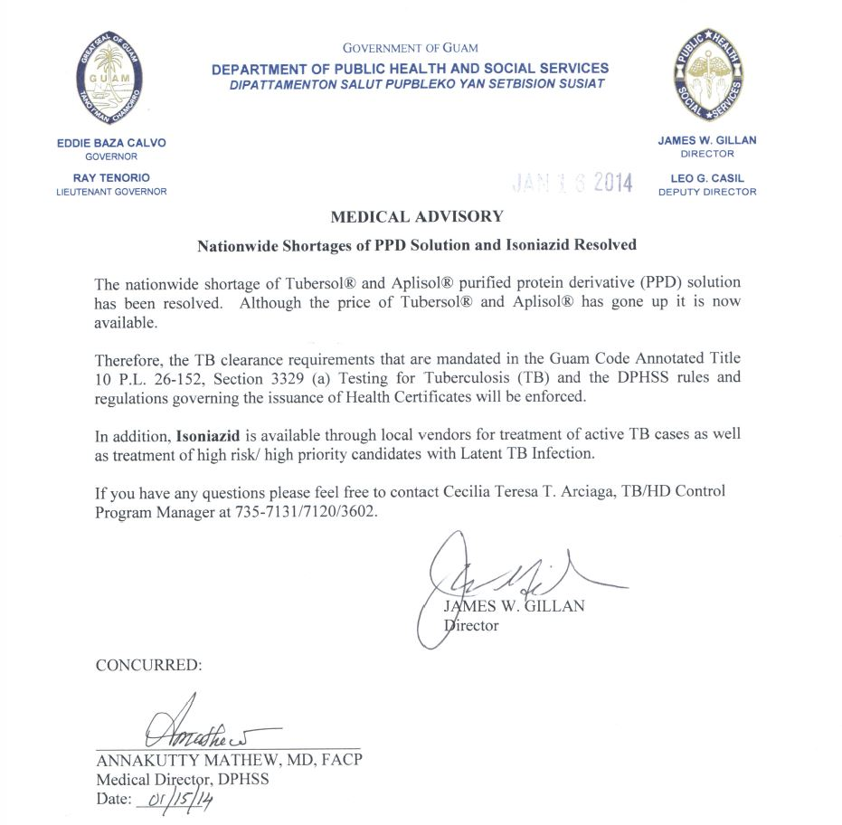

Slide 17
