Slide 1
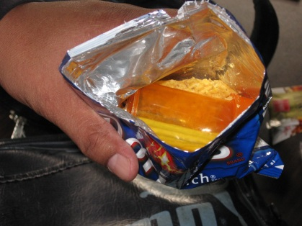

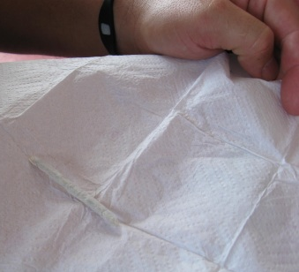
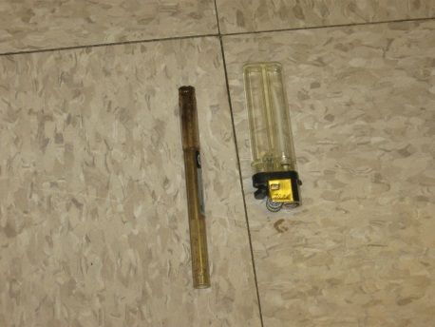
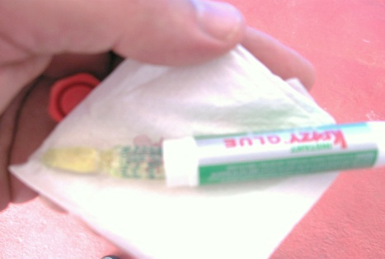
SEARCH & SEIZURE
PRESENTED BY
CUSTOMS OFFICER JOHN ROBERTO

Slide 2
SEARCH & SEIZURE
The Fourth Amendment restricts public school officials, but to a lesser degree than are the police. The Fourth Amendment does not apply to private or parochial school officials.
School officials may search students and their belongings with “reasonable suspicion.”
The police may also search with “reasonable suspicion” (as opposed to their usual "probable cause" standard) if they are working at the request of and in conjunction with, school officials.

Slide 3
SEARCH & SEIZURE
CONTRABAND DEFINED:
Any counterfeit currency, illegal substances, drugs, drug paraphernalia, prescription drugs without a prescription, tobacco, improvised weapons, knives, machetes, handguns, rifles, shotguns or Improvised Explosive Devices (I.E.Ds), grenades, flash grenades, smoke bombs, or components of IEDs.

Slide 4
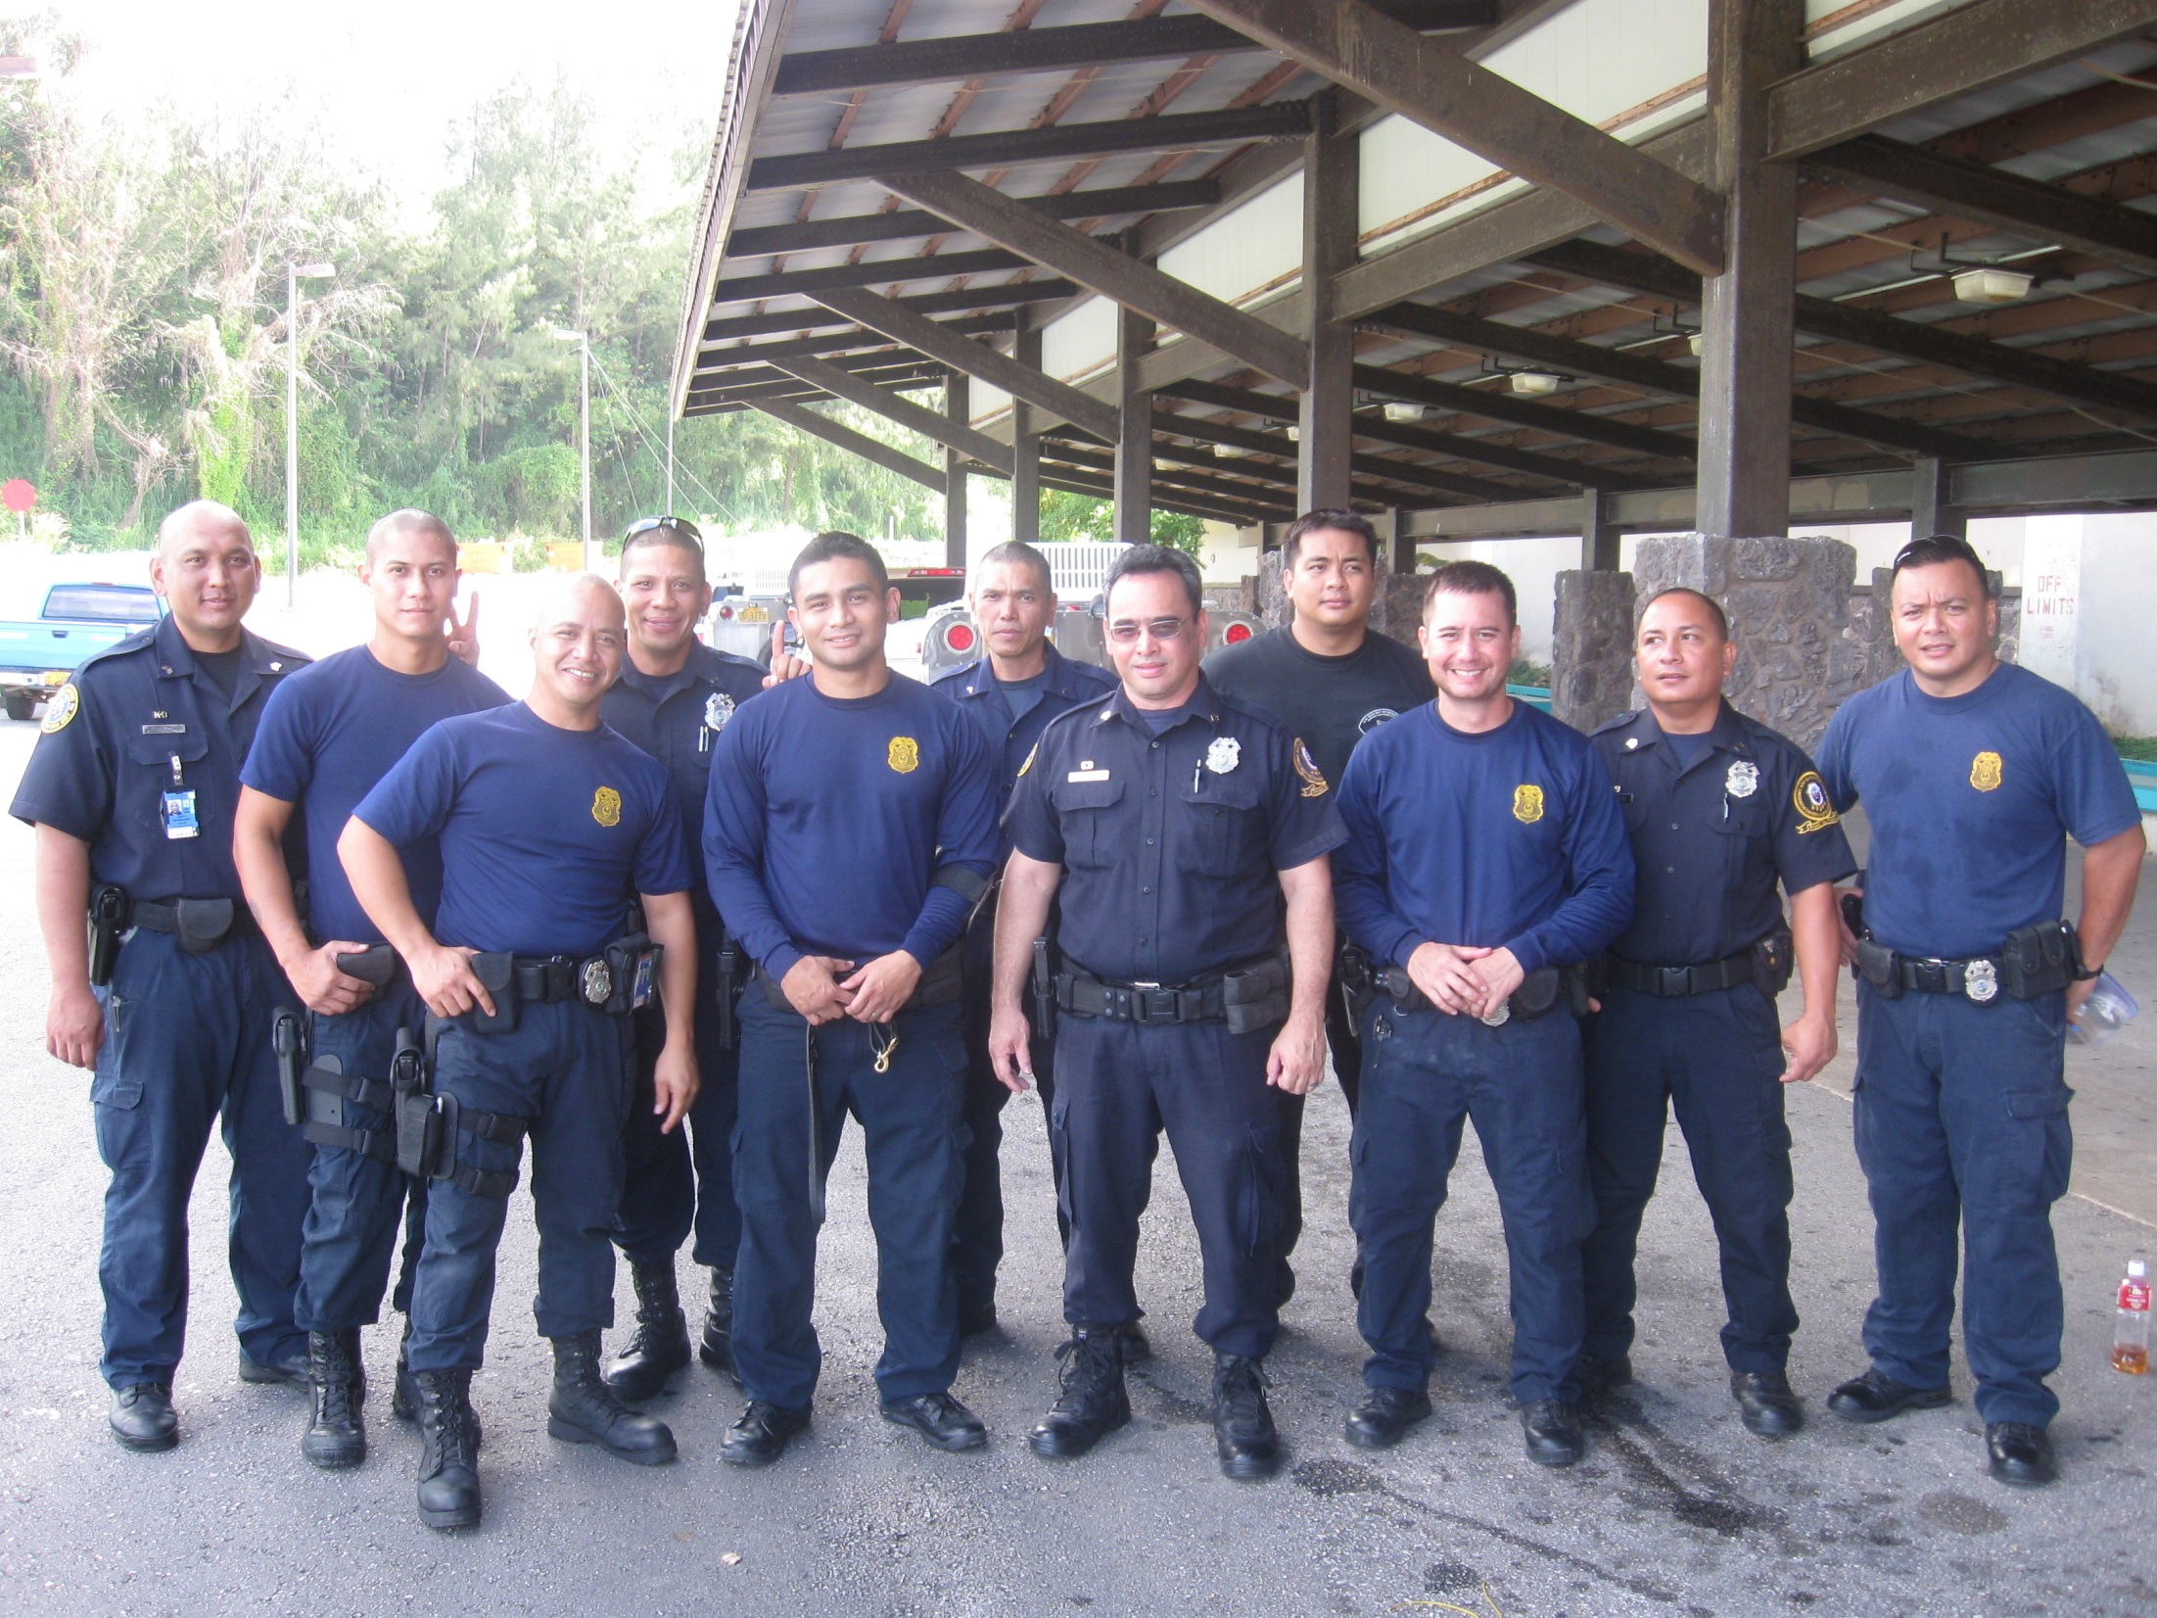
C&Q Canine Team
@ Southern High

Slide 5
TYPES OF SEARCHES
Consensual
Non-Consensual (Random/or w/Reasonable Suspicion)
Searches of Student’s Person & Belongings
Locker Searches
Vehicle Searches
Drug Detection Canines (Operation Clean Sweep)
Point of Entry/Exit Inspections

Slide 6
TYPES OF SEARCHES
Consent must be voluntary and not the result of coercion, undue influence or threat and without the threat of punishment.
For example, a student who is told that if he must comply with a request to empty his pockets or face discipline cannot be said to have voluntarily consented to the search, even if he dutifully complies with the request.
The question of whether consent was voluntary is determined from the totality of the
circumstances.

Slide 7
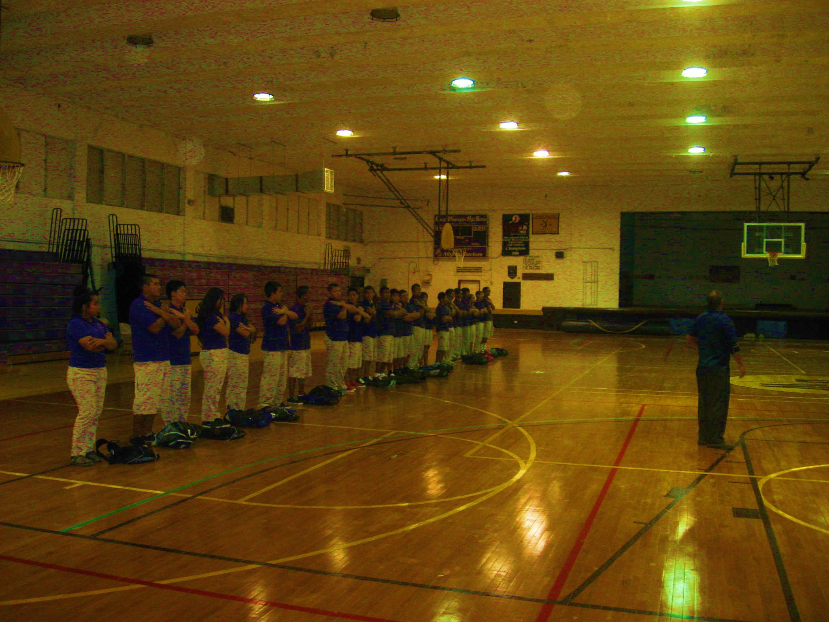
Operation Clean Sweep
@ GWHS Gym

Slide 8
CONSENT SEARCHES
KEY POINTS:
In order for consent to be valid, the consent must be voluntary and the person giving consent must have the authority to do so.
Consent does not have to be in writing but it is preferable that it be so.
A refusal to consent does not give a school official reasonable suspicion to believe the student is hiding something.
It is recommended that the student be advised as to what a school official is searching for prior to asking for consent to search.
Consent to search a generalized area is a consent to search any items found in that area.

Slide 9

C&Q Canine Team @ OVMS

Slide 10
NON-CONSENSUAL SEARCHES
Searches of a Student’s Personal Belongings
When school officials have a reasonable suspicion to believe a student has contraband or evidence of a violation in his or her jacket or other outer clothing, backpack, purse, or other bag, the student should be asked to put the object down and remove any outer clothing so that these objects can be searched without
physically touching the student’s person. It is especially important to give the student the option to “come clean” with the object being sought without touching the student because searches of the student’s person are particularly invasive.

Slide 11
Conducting The Search
Searches of a Student’s Personal Belongings……
Search property in the presence of the student and an observer.
Before beginning ask the student if there is anything within the item to be searched that he/she would like to declare before the search is conducted.
Ask the student to empty the contents of the bag, backpack, purse, jacket etc.

Slide 12
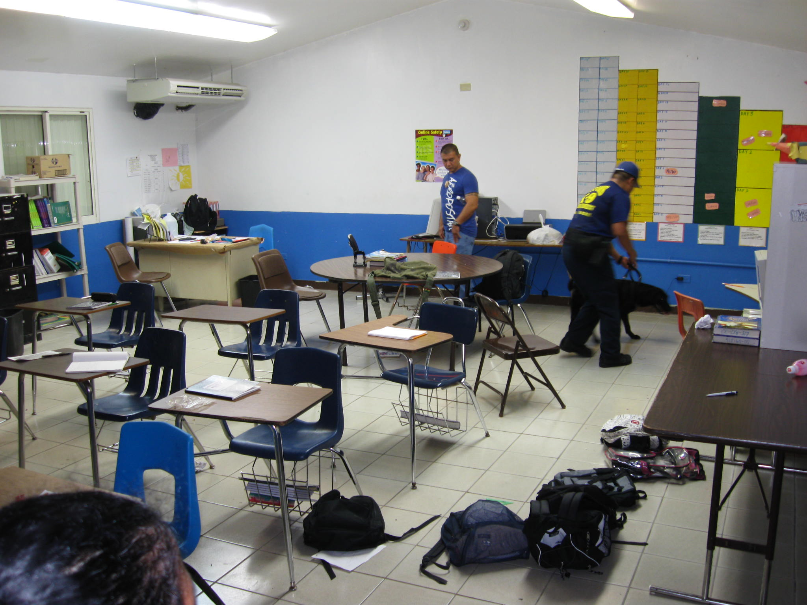
Classroom Sweep

Slide 13
Conducting The Search
Searches of a Student’s Personal Belongings……
Examine the contents thoroughly.
Examine the bag, backpack, purse etc. thoroughly.
The observer will study the student for any signs of nervousness, sweating or other signs during the search and take pictures when possible.

Slide 14
Conducting The Search
Searches of a Student’s Personal Belongings……
7. If any contraband is found, confiscate and follow protocols set by school policy/SOPs.
8. Thank the student for their patience, have them collect all items and return to class.

Slide 15
Conducting The Search
Searches of a Student’s Person
Begin by asking the student if they have anything illegal in their possession before beginning the search.
Instruct the student to empty all pockets by pulling the lining inside out.
Observer will watch the student at all times for attempts to discard items and for any “sudden movements or aggression” and be ready to restrain.

Slide 16
Conducting The Search
Searches of a Student’s Person
If a pat down is warranted use an SRO or administrator of the same sex to conduct the pat down in the presence of an observer.
Conduct the pat down with the “least amount of intrusion” as possible.

Slide 17
Conducting the Search
KEY POINTS:
Always conduct the search with an observer to monitor the student and be witness.
Allow the student the opportunity to give up any contraband prior to the search.
Allow the student to empty the contents of their property or person.
Follow school policy/protocols for confiscation of all contraband.

Slide 18
CONDUCTING LOCKER SEARCHES
Always conduct the search in the presence of an observer/witness.
All confiscated contraband will be handled in accordance with DOE policies/procedures.
When possible, search the locker in the presence of the “student”, but with privacy. If a weapon is suspected it would be advisable to have an police officer or SRO present.

Slide 19
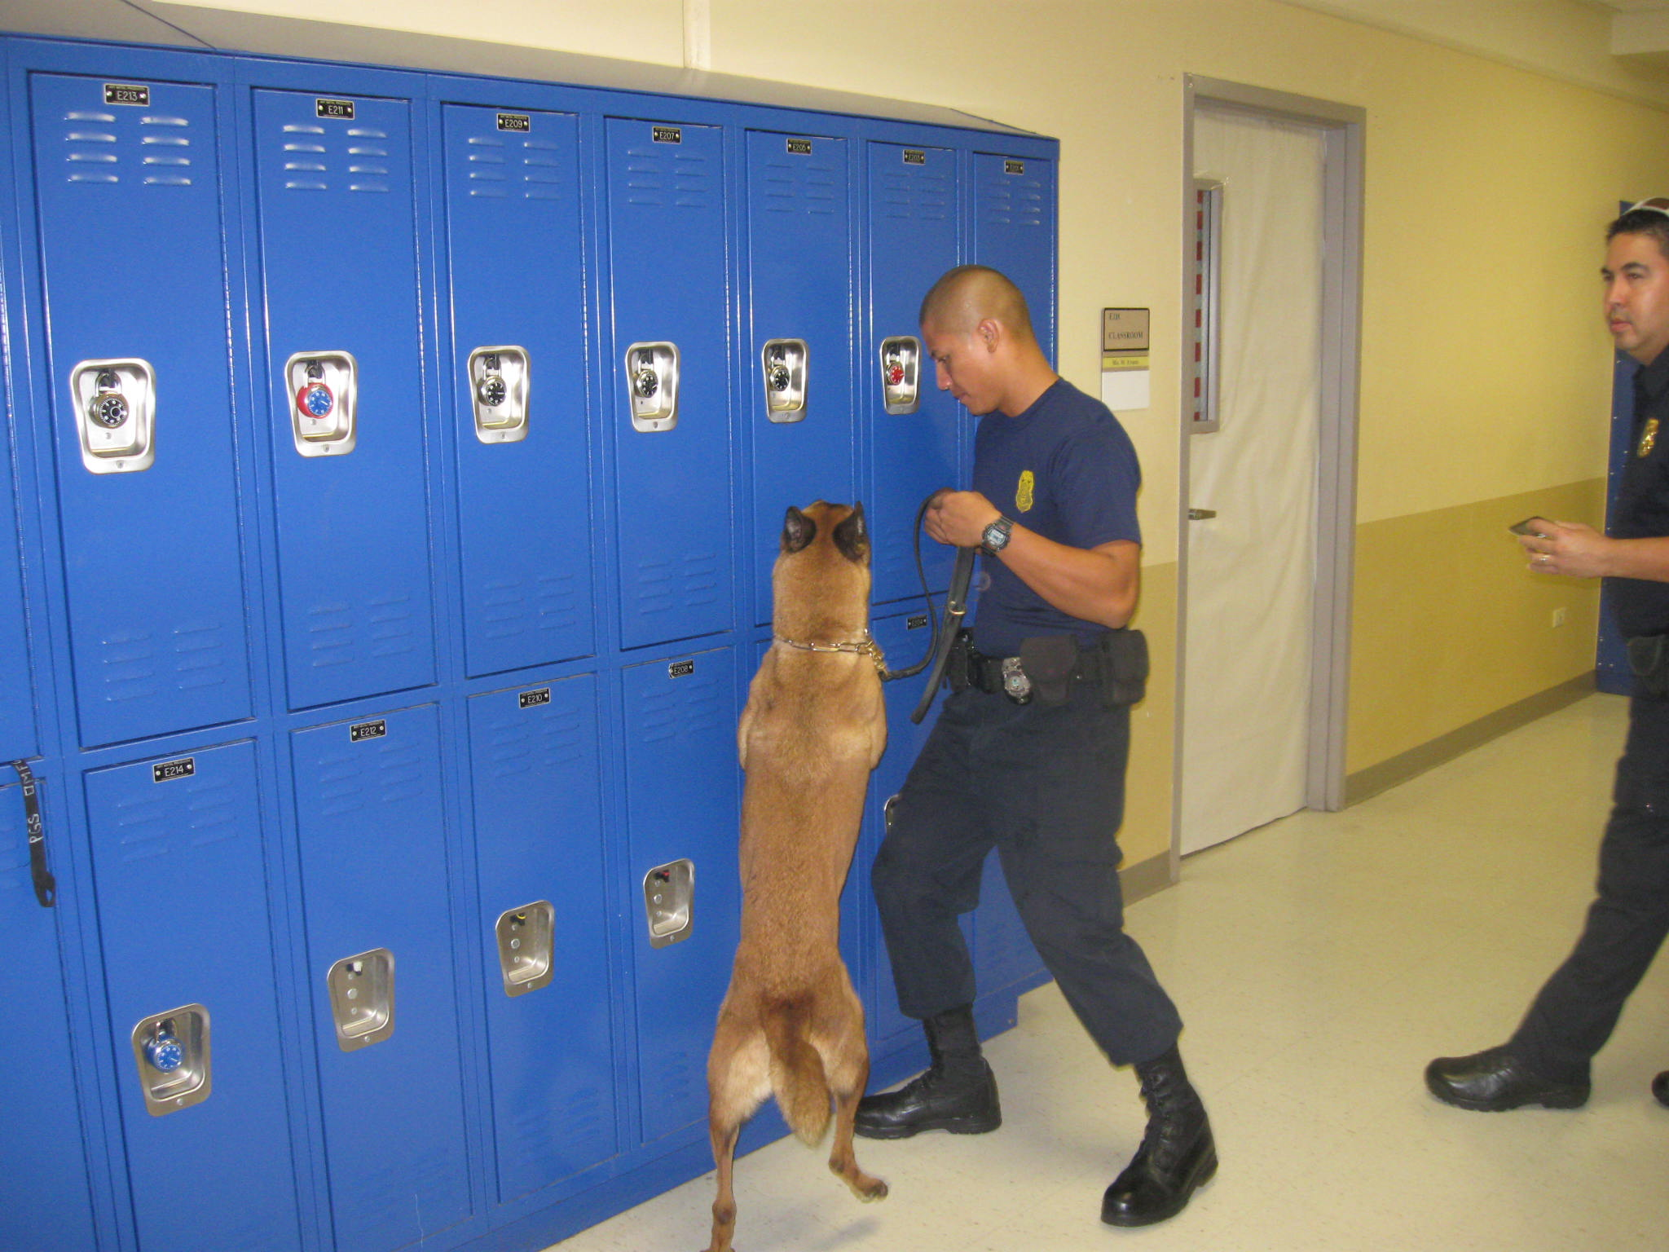
Sweeping Lockers @ AMS

Slide 20
CONDUCTING VEHICLE SEARCHES
Have the student present and under the control of the observer. (A weapon could be concealed in the car and be used against you.)
Give the student the opportunity to “declare” any contraband prior to the search.
Use a drug dog whenever possible for a thorough sweep of the vehicle.
Unlock the car and begin the search working from the front to the rear of the car.
Follow DOE procedures/policies for any contraband confiscated.

Slide 21
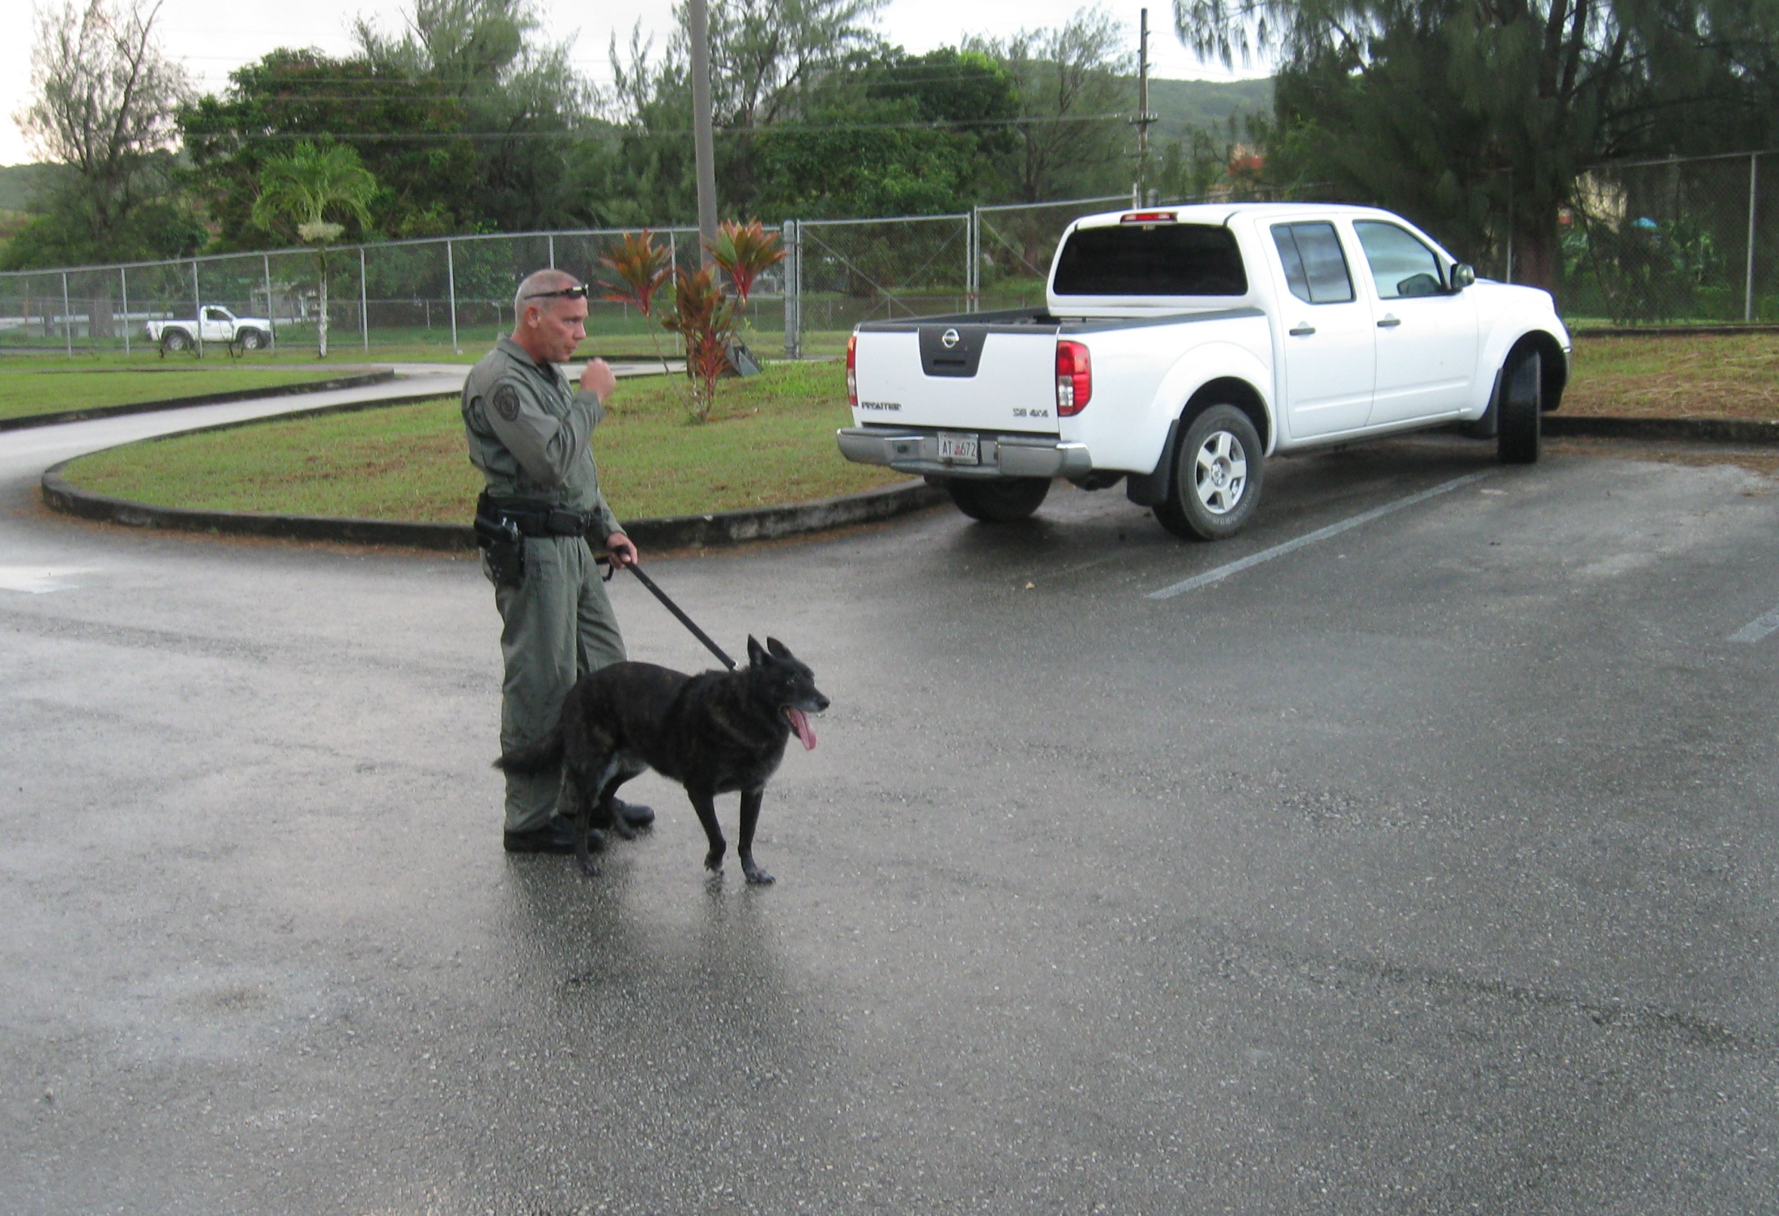
Let’s sniff that truck….

Slide 22
DRUG-DETECTION CANINES
In 2009 a Memorandum Of Agreement (MOA) was signed by Governor Camacho, DOE Superintendent and the Customs & Quarantine Director in support of “Operation Clean Sweep” using the C&Q Canine Division.

Slide 23
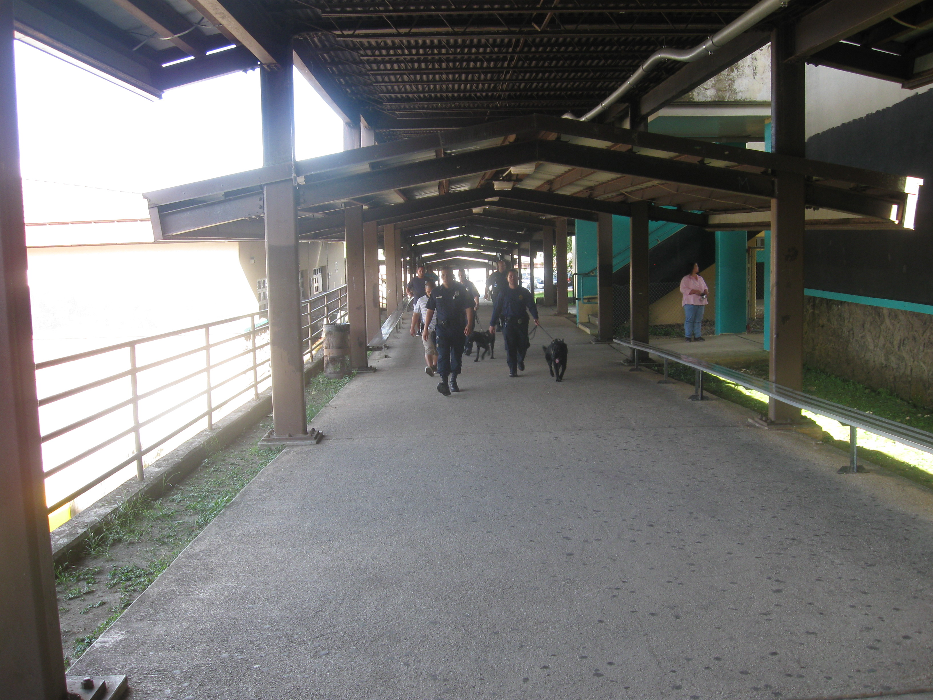
Operation Clean
@ SHS

Slide 24
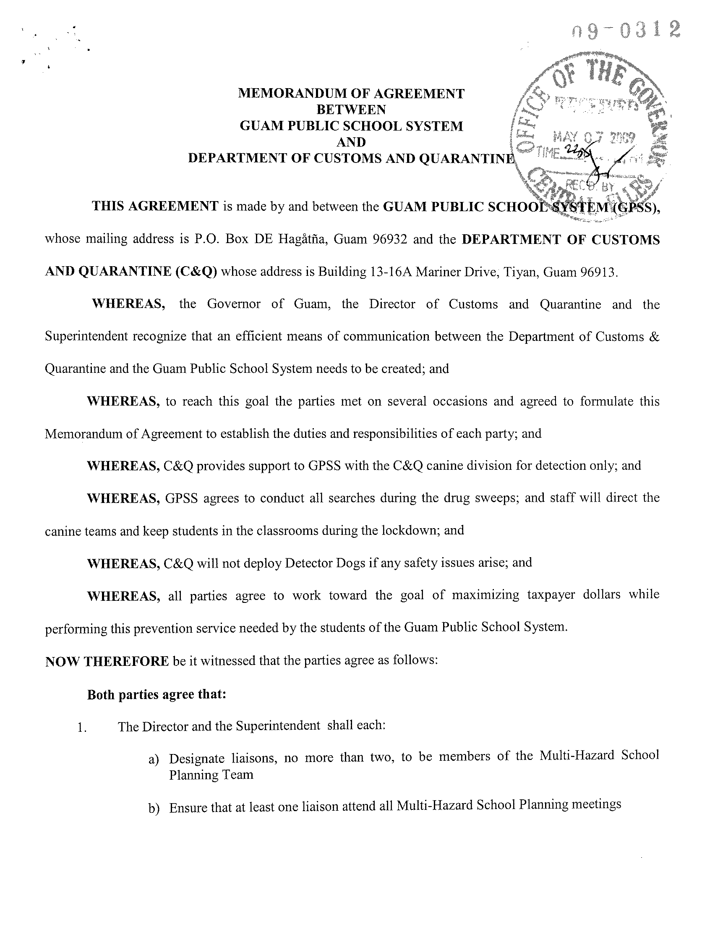

Slide 25
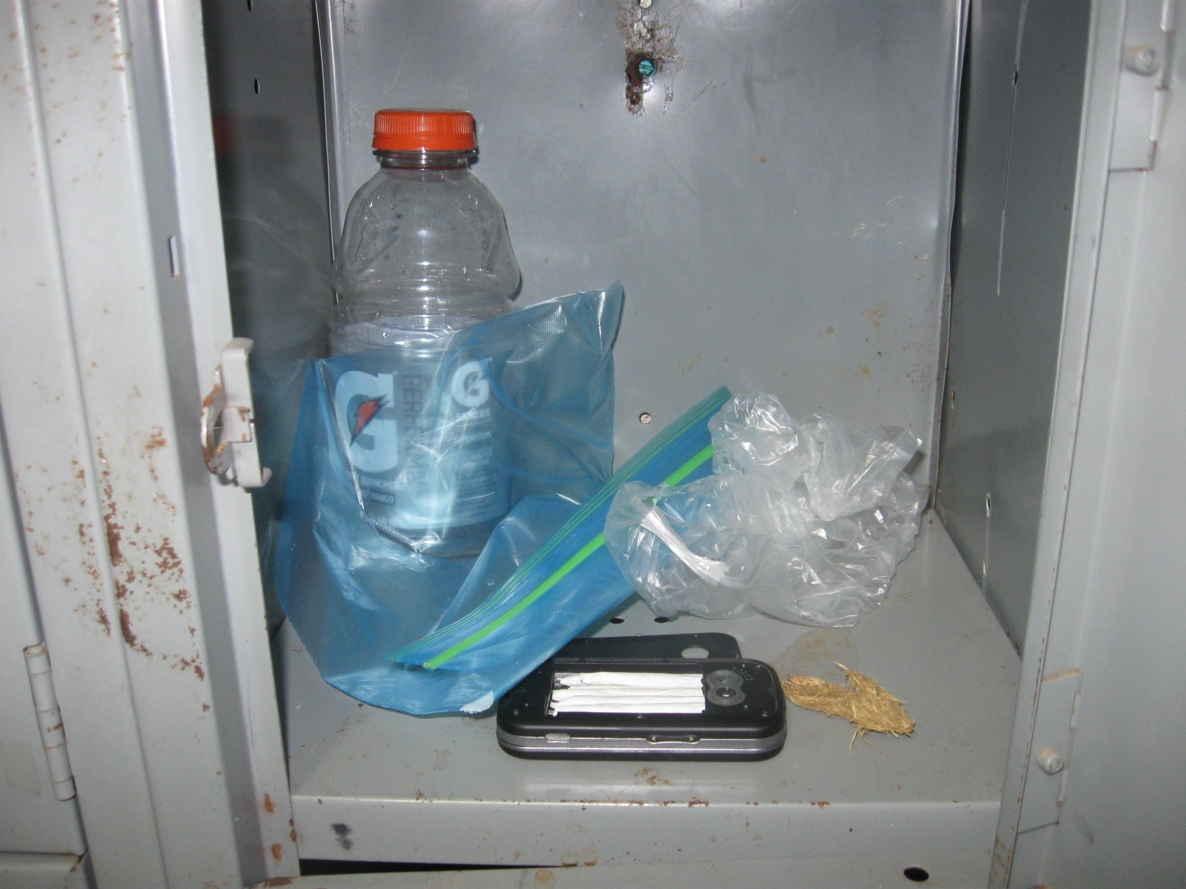
5 JOINTS IN CELL PHONE BATTERY COMPARTMENT
IN AN
UNLOCKED
LOCKER
SSHS

Slide 26
SEARCH & SEIZURE
PRACTICAL EXERCISE

Slide 27
SEARCH & SEIZURE
QUESTIONS?

Slide 28
SEARCH & SEIZURE
THANK YOU

