Slide 1
Honor Society Of Nurses
Sigma Theta Tau International
Anna Varghese
R.N.M.S.N
Faculty , U.O.G

Slide 2
Sigma Theta Tau International
What is a (STTI)Nursing Honor Society?
An honor society is a group of nurse scholars and leaders recognized for their superior achievement, leadership qualities, high professional standards and commitment to the profession of nursing.

Slide 3
STTI - History
The Honor Society of Nursing, Sigma Theta Tau International (STTI) –
In 1922 six nurses founded STTI at the Indiana University Training School for Nurses, now the Indiana University School of Nursing, in Indianapolis, Ind., USA.
The founders chose the name from the Greek words Storgé, Tharsos and Timé meaning "love," "courage" and "honor."
STTI became incorporated in 1985 as Sigma Theta Tau International Inc., a nonprofit organization with a 501(c)(3) tax status in the United States

Slide 4
STTI Mission
The mission of the Honor Society of Nursing, Sigma Theta Tau International is to support the learning, knowledge and professional development of nurses committed to making a difference in health worldwide.
.

Slide 5
STTI Vision
The vision of the Honor Society of Nursing, Sigma Theta Tau International is to create a global community of nurses who lead in using knowledge, scholarship, service and learning to improve the health of the world’s people.

Slide 6
STTI- purposes
1. Recognize superior achievement and scholarship.
2. Recognize the development of leadership qualities.
3. Foster high professional standards.
4. Encourage creative work.
5. Strengthen commitment to the ideals and purposes of the profession.

Slide 7
STTI – Members
STTI has more than 130,000 active members.
Members reside in more than 85 countries.
There are 486 chapters at institutions of higher education throughout Australia, Botswana, Brazil, Canada, Colombia, England, Ghana, Hong Kong, Japan, Kenya, Malawi, Mexico, the Netherlands, Pakistan, Singapore, South Africa, South Korea, Swaziland, Sweden, Taiwan, Tanzania, the United States and Wales.

Slide 8
STTI- membership
Membership can be conferred in one of the following membership categories:
Undergraduate students
Master’s students
Doctoral students
Professional Nurses
Nurse leaders

Slide 9
Student Nurse
Students in baccalaureate programs shall be eligible for membership if they have achieved excellence according to the standards approved by the society.
Complete at least ½ of the nursing curriculum.
Students in graduate programs shall be eligible for membership if they have achieved excellence according to the standards approved by the society.

Slide 10
Nurse
Hold a minimum of a baccalaureate degree or the equivalent in any field.
Registered Nurses with a baccalaureate degree or the equivalent in nursing are eligible.
Registered nurses with a baccalaureate degree in fields other than nursing are also eligible for membership.

Slide 11
Nurse Leaders: Criteria
Nurse Leader Candidates must:
Be legally recognized to practice nursing in his/her country
Have a minimum of a baccalaureate degree or the equivalent in any field
Demonstrate achievement in nursing
Candidates will be asked to explain how they have met the Achievement in Nursing Categories

Slide 12
Nurse Leaders
Examples of nursing excellence:
Preceptorship
Publication
Service on a board, or advisory council
Community outreach
Adjunct Instructor
Policy development

Slide 13
Starting an STTI Chapter - Gu
STTI currently has more than 480 chapters around the world
The minimum requirements for a school to start an STTI chapter include:
Institution of higher education grants a minimum of a baccalaureate degree or equivalent in nursing
School's nursing programs are accredited by an appropriate accrediting body recognized by the STTI Governance Committee
Obtained support from the institute of higher education and the educational unit with the nursing program for an STTI chapter

Slide 14
Phases of Honor Society and Chapter Development
Chapter establishment is a six-phase process.
To establish a new chapter, groups must first form a local honor society at their institution of higher education. (GHSN)
This developing honor society shall complete the tasks outlined within each phase of development to learn, grow, apply and transition into a successful and sustainable chapter.

Slide 15
Guam Honor Society For Nurses
Guam Honor Society for Nurses Is the initial organizational Nursing Honor Society in preparation to establish a Sigma Theta Tau International Chapter.
Started in February 2013 at UOG
A steering committee made up of local nurse leaders , nurses and student nurses formed the Guam Honor Society for Nurses (GHSN).

Slide 16
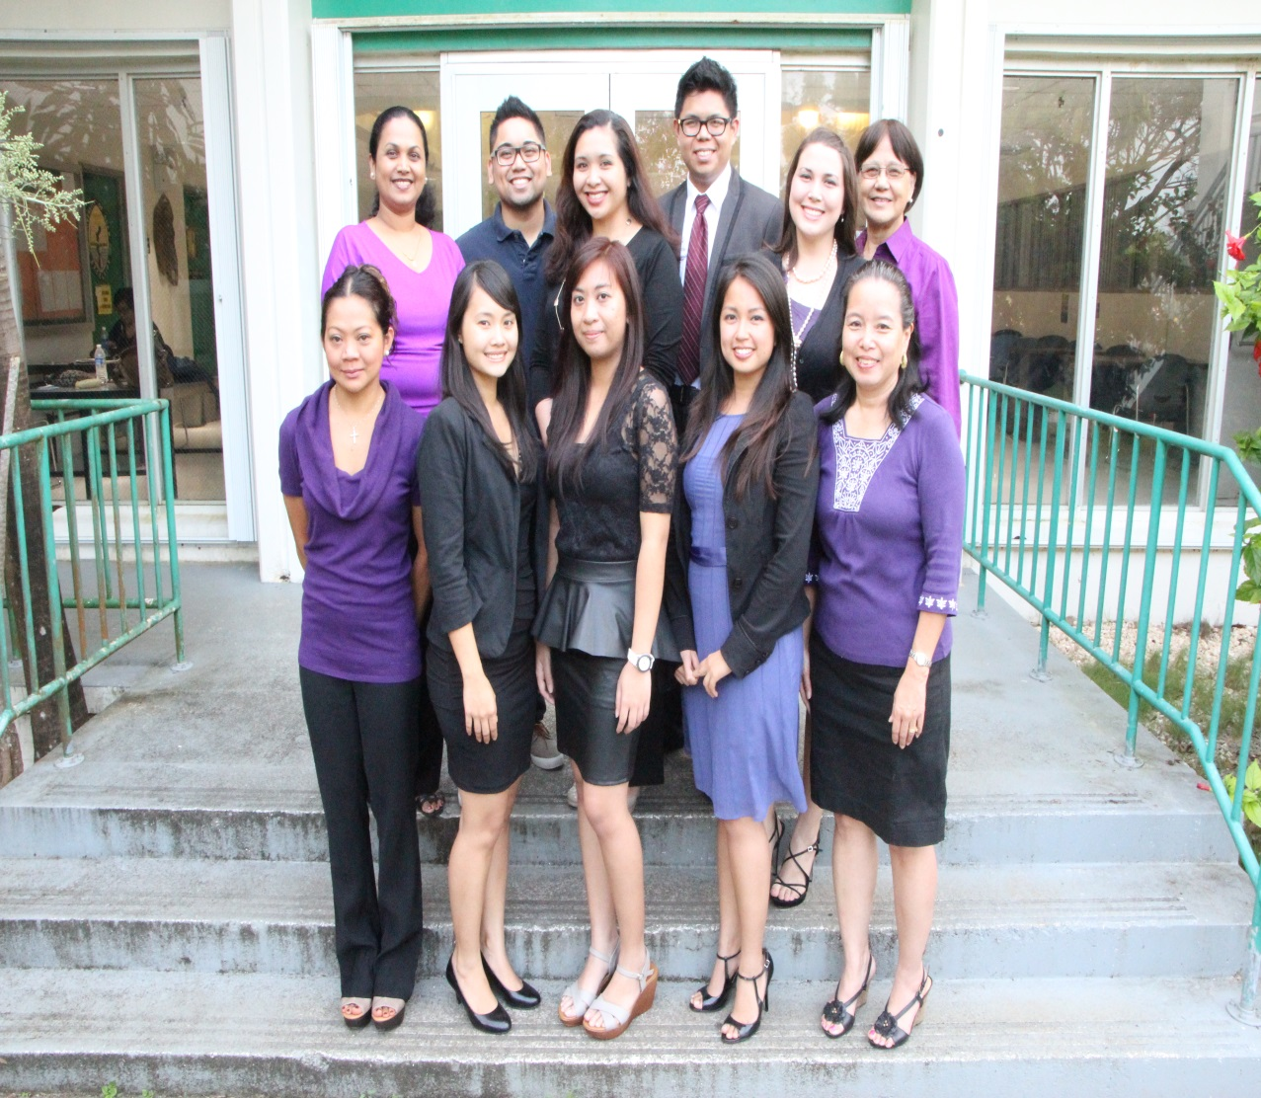

Charter members(GHSN)
President: Anna Varghese
Vice President: Dorothy Manglona
Secretary: Adrian Medina
Treasurer: Teofila Cruz
Counselor: Bryan Bansil
Other Members: Richie Recomono, Margaret Hattori-Uchima;
Student Members: Layla Story,
Fides Batac, Rivalyn Duenas,
Gizelle Valencia

Slide 17
Guam Honor Society for Nurses(GHSN)
How to apply:
Submit a CV to the Guam Honor Society by
e-mail for review and approval.
Email: guamhsn@gmail.com
Membership Dues:
Student/Retired RN members: $30.00
Employed RN: $50.00

Slide 18
STTI
Thank YOU!
Questions???

