Slide 1

Guam Comprehensive School Counselor Program K-12
December 20, 2012
Presentation to the Curriculum Textbook Committee (Part II)

Slide 2
GUAM COMPREHENSIVE SCHOOL COUNSELING TEAM
Josephine C. Caluag, Ph.D. DOE Counselor Emeritus, GASC Founding President Mentor, ASCA National Model
Billie-Jo P.J. Marzan, Ed.D. Machananao Elementary School Foundation Team | Francis S. Ballares, M.A John F. Kennedy School Management System Team
Estela L. Calata, M.A Wettengel Elementary School Delivery System Team | Jovita M. Young, M.S D. L. Perez Elementary School Accountability System Team
Ross Schlosbon District Psychologist Student Support Services Division | Christopher Anderson Administrator Student Support Services Division

Slide 3
COUNSELING FRAMEWORK
Guam Comprehensive School Counselor Program K-12 Provides Structure at the Following Levels:
  Student (Standards /Competencies/Indicators-pages17-24)
  School Guidance Counselor (Standards-Process for Annual Evaluations/Position Description-pages 46-47)
  Program (Program Audit-pages 52-62)

Slide 4
AGENDA (Part II)
Packet Review
Recommendations from the November 29, 2012 Meeting-
Request to Amend GCSCP K-12:
A. ASCA National Standards in Chart form to clarify that
there are 3 Domains, 9 Standards, 16 Competencies and
120 indicators (TAB A); (TAB A1) – Insert (Appendix B; Pg
51)…Merge TAB A and A1)
B. Crosswalk Tool (TAB B); (TAB B1)
  1. No Recommended/Prescribed ASCA standards
  2. Based on research, each state is recommended to form a
  cadre of representatives from each grade level to select
  the competencies K-12. (See Reference Pg. 35)
  C. ASCA Standards-Group work of SGCs 2nd Annual School
  Counselors' Conference (2006) - competencies for each
  standards were chosen. (TAB C)

Slide 5
AGENDA (Part II)
II.
  D. Sample Lesson Plans:K-2, 3-5,6-8,9-12 address
  how students are assessed (Pre-test and post test
  Counselor made tests)--includes--process data,
  perception data, results data) (TAB D)
  III. Questions/Answers

Slide 6
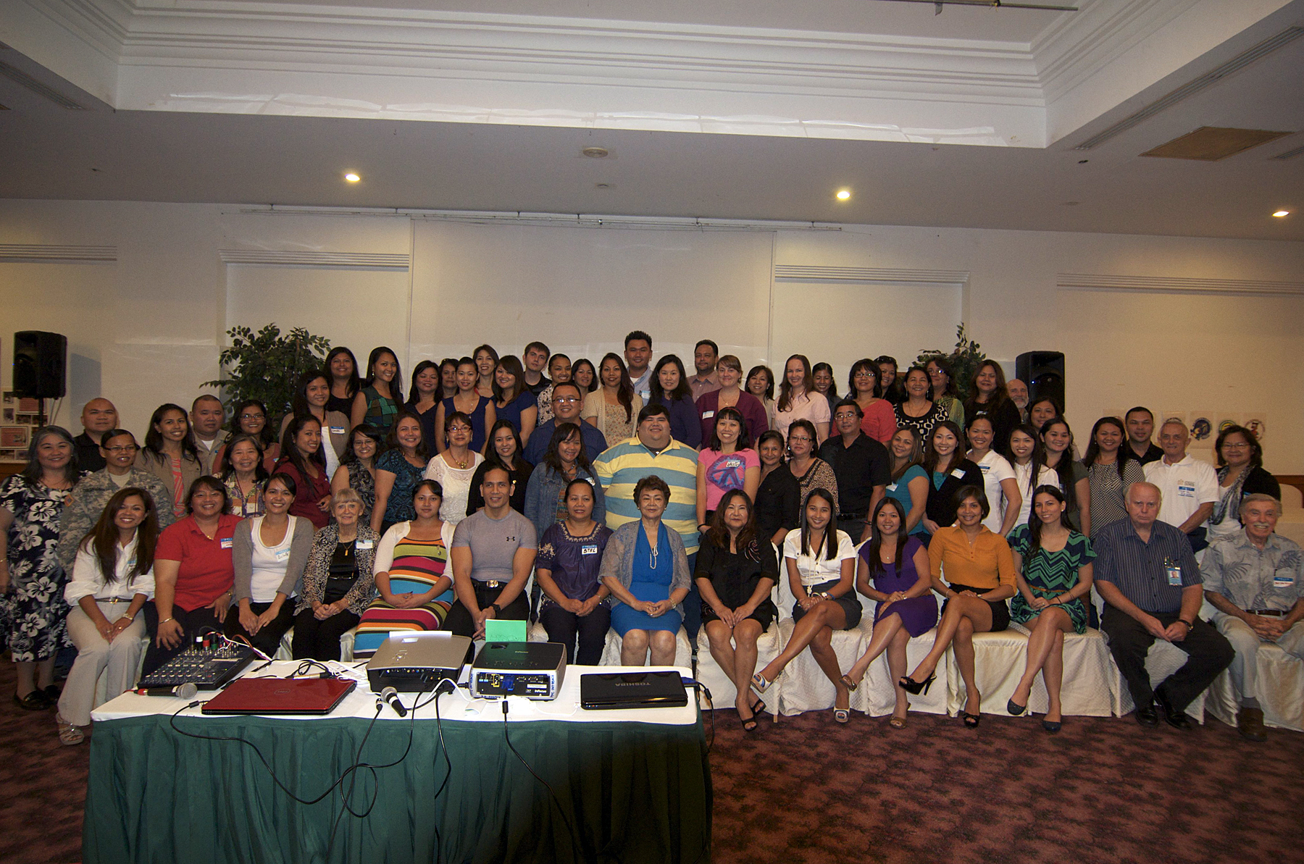

QUESTIONS/CLOSURE

