Slide 1
2014 BSBF PROGRAM
GUAM

Slide 2
Contents
Feedback - 2013 report
Re-visit BSBF Objectives & Impact
2014 plan - Tooth Defenders’ materials & Implementation
Reporting
Tooth Defenders’ evaluation form

Slide 3
Feedback – 2013 Report
‘Tooth Kingdom series’
Overall, it is an outstanding result and is to be commended.
Interpretation method of the evaluations is unclear, but it is clear that they love the current program.
Every element rated mostly as 5 (Excellent) and 4 (Very Good).
The only element that might be of concern is the Fun Games. The Fun Games are not as integral a part of the program as the Legend of Tooth Kingdom DVD where most of the Oral Health learning and Teacher Guide activities are focused.
This is still an excellent result and would interest, connectivity or time be a constraint for a teacher to elect not to use?
Didn't use: 9% Didn't answer: 8%
Recommendation:
All the component ratings and comments are good. However, it is recommended that we keep with this program for at least another two years, so that the teachers can be familiar with the existing program and are able to use it more confidently in the new year.
2014 – launch of the ‘Tooth Defenders’ series in Guam

Slide 4
Revisit - BSBF Objectives
Educate the children on good oral health practices.
Empower them to take control of their own health
Provide skills which they can carry through to adolescence and adulthood
The main Oral Health messages are:
The importance of brushing at least twice a day
Use fluoride toothpaste
Regular visits to the Dentist
Limiting the frequency of sweets and sticky foods

Slide 5
To evaluate the Impact of the BSBF program in schools:
Process used were:
Education and
Empowerment – provision of right information, tools & supervision
Impacts to be evaluated:
Are the children committing to brushing their teeth with fluoride toothpaste? [consider frequency]
Are the children visiting the Dentist?
Has there been a reduction in the consumption of snacks and sweets? [diet]

Slide 6
Targets and Influencers
In 2013 the Influencers have been:
Teachers
Nurses
Primary HC
Providers
NGO’s
Community Orgs
TEE
PARENTS
Has there been
involvement / commitment
from other circles of
Influencers in 2013?
Parents [PTAs]
Professionals
Teachers
TEACHERS
KIDS
Government
School nurse
Marketing
PROFESSIONALS
Community
Leaders
Many INFLUENCERS
Target: KIDS

Slide 7
2014 PLANS

Slide 8
Tooth Defenders’ Materials
Guam - now in synchrony with US BSBF program and it’s a better option logistically as supplies are sent direct from USA to Guam free of charge – thanks to MBI team
Tooth Defender materials to be used for the next 3 years at least, as next series will be developed over the next few years.
Other educational materials / activities are available on the website: www.colgatebsbf.com
Kit has the label – ‘Kindergarten Classroom kit’:
Despite the label, the contents of the materials are relevant for all grades involved in the BSBF program.

Slide 9
Tooth Defenders’ Materials
Teacher Receives: (within each box) | Students Receive: (Teacher distributes from box) | Other: (with nurses)
1 X Poster (back to back): How to Brush Key Oral Health messages | 1 X Toothbrush | Teeth model & toothbrush – distributed in 2013
1 X Tooth Defenders DVD | 1 X Toothpaste sachet
1 X Oral Health Activity Guide | 2 x Educational brochures
1 X A3 Tooth Defenders storybook – ‘How it all began’ | 1 X storybook – ‘How it all began’ (smaller version)
Tooth Defenders’ kits will be replenished annually. 25 participant kits & mini storybooks are in the Teacher’s box for the students. Each student will also receive an extra tube of toothpaste that will be handed out by the teachers.

Slide 10
Implementation
Tooth Defenders’ Materials
Begin with the story ‘How it all began’ using the DVD or story book. There are 6 Tooth Defender trainings & activities in the Oral Health activity guide for class activity. Take ample time [period] for each activity to ensure that all the children complete each task & understands the key messages. DVD, storybook & posters are the references for the activities. Spread out the trainings & activities throughout the year. Teachers to handout kits for each student after the 1st session. Emphasize on using the contents of their kits [TB & TP] as tooth defender weapons. Other class activities available on: www.colgatebsbf.com
Note: Annually assess the children’s compliance to the key BSBF messages; Identify ‘weak’ areas & focus Oral health education on messages & activities that address these areas.

Slide 11
Reporting
Evaluation form to be filled and submitted at the end of the school year [annually] - 2013 Guam report was for the first quarter.
Process similar to 2013 – schools -> DOE -> MBI / CP
Annual evaluation:
Assessment of utilization of materials & comments over the year will highlight areas that need to be addressed / improved.
Able to assess program impact on the lives of the children.
Question: Has there been any follow up with the 6 schools that did not submit forms in 2013?

Slide 12
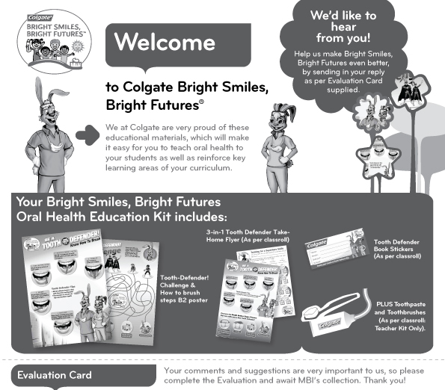
Tooth Defenders' Evaluation form
Will be distributed to the schools

Slide 13
Thank you & best wishes for the 2014 BSBF launch!

